Slide 1
Unmanned Aircraft System Security Model Survey
Matthew Whitesides
Professor Bruce M. McMillin
CS6600: Formal Methods in Computer Security

Slide 2
Outline
Unmanned Aircraft System Overview
Security Model Scenario
ACM & System Overview
Rights Leakage Findings
HRU
T-G
Security Classification Solutions
Q&A

Slide 3
Unmanned Aircraft System Overview
Unmanned Aircraft Systems (UAS) are air vehicles and associated equipment that do not carry a human operator.
They are instead are remotely piloted or fly autonomously.
Generally within an organization, a UAS can encompass the whole system of an unmanned aerial vehicle (UAV), control stations, command operations, maintenance systems, etc.

Slide 4
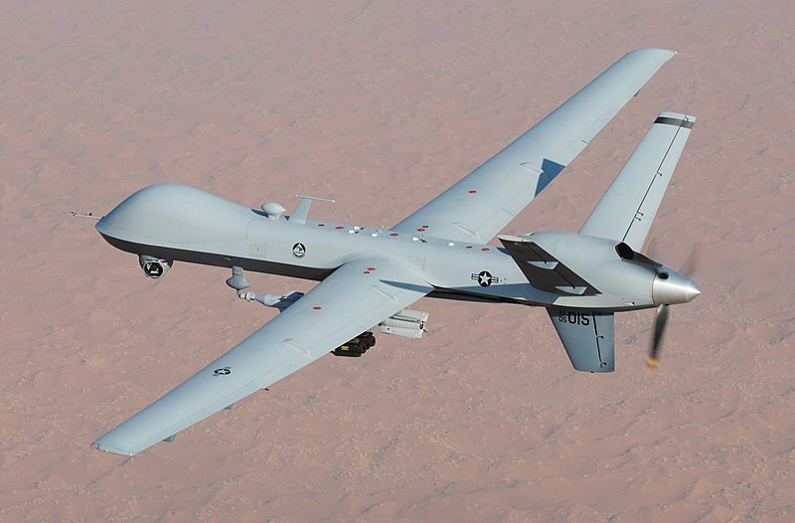
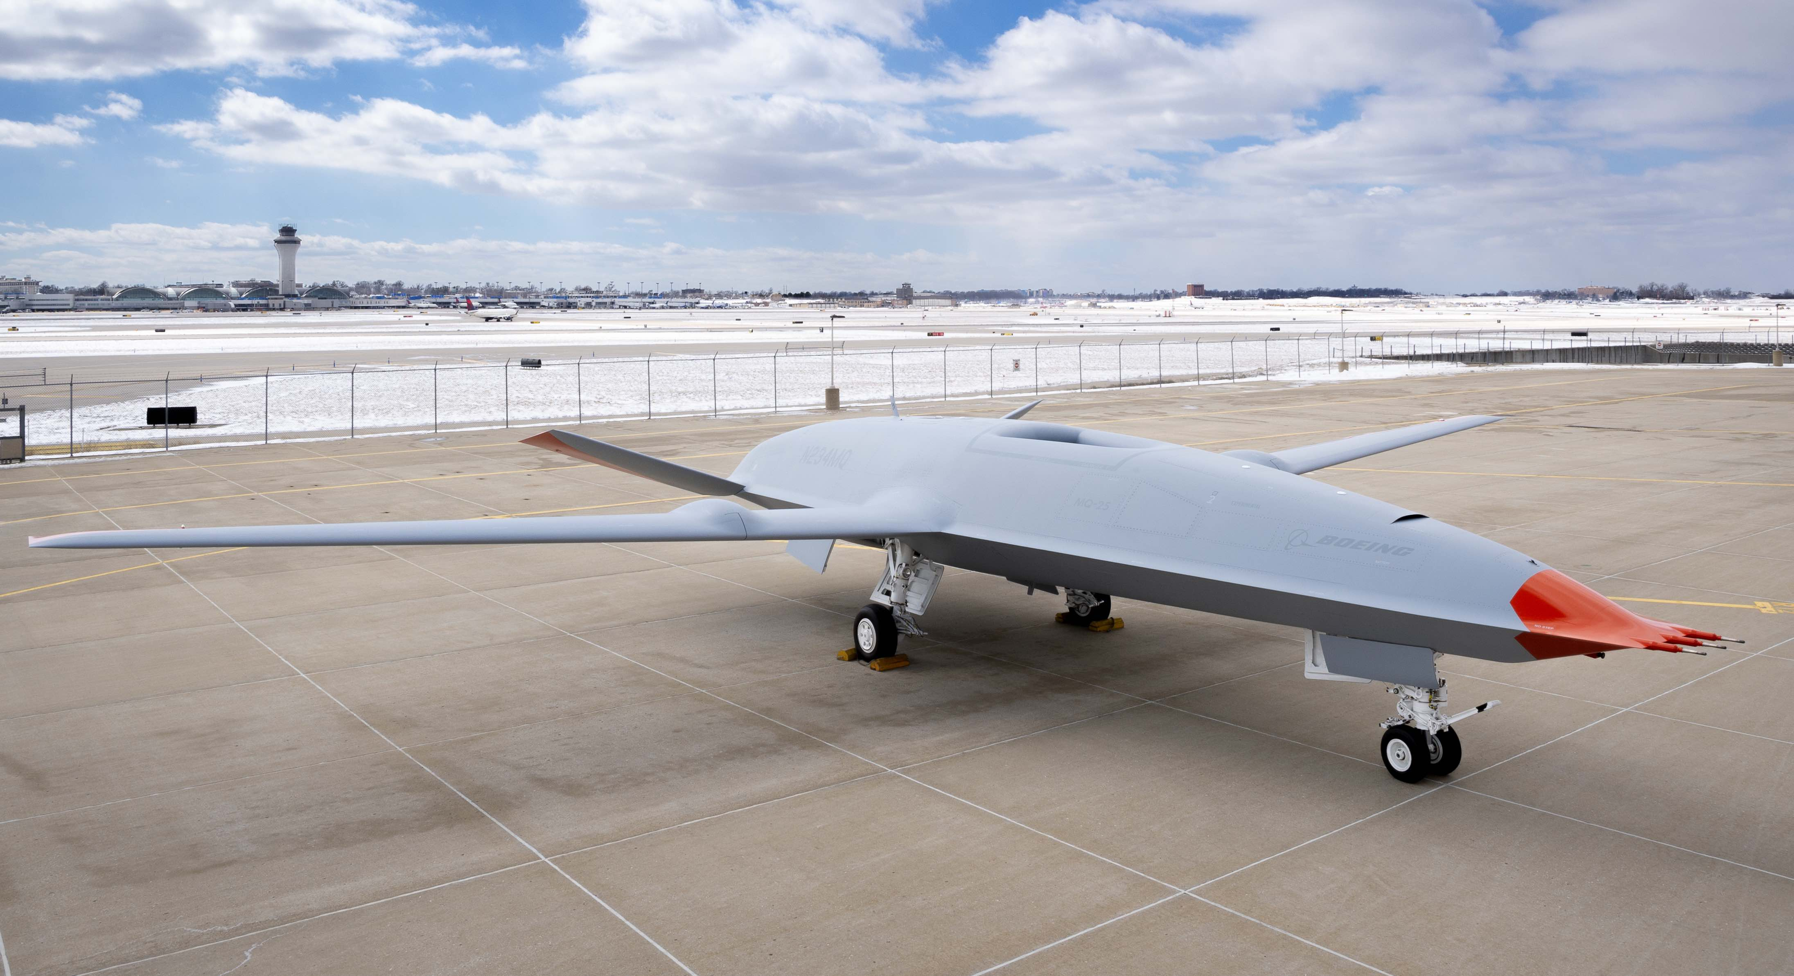
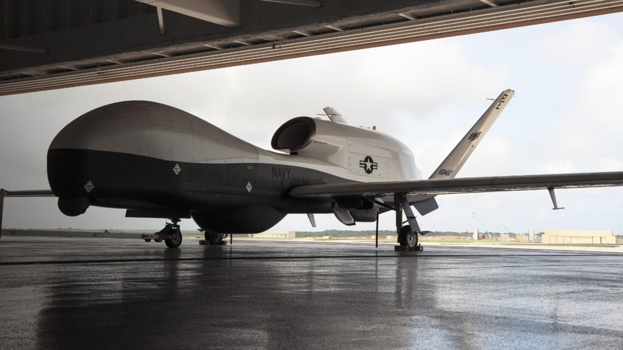
Unmanned Aircraft System Overview
Some examples of UAVs include:
General Atomics MQ-9 Reaper | Boeing MQ-25 Stingray | Northrop Grumman MQ-4C Triton

Slide 5
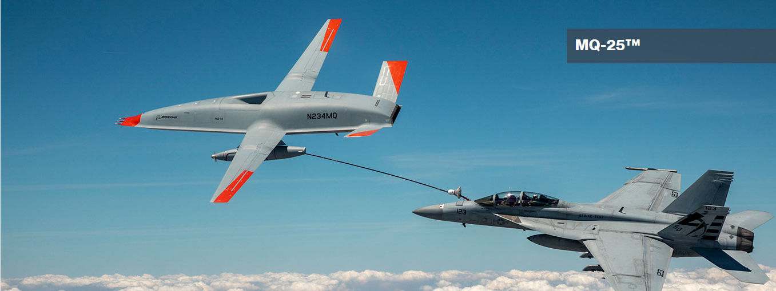
Unmanned Aircraft System Overview
For this security model simulation, we will take inspiration from an autonomous refueling aircraft.
These UAVs enable mid-flight refueling capabilities for larger aircraft to enable longer-range mission capabilities.
Boeing MQ-25
https://www.boeing.com/defense/mq25/

Slide 6
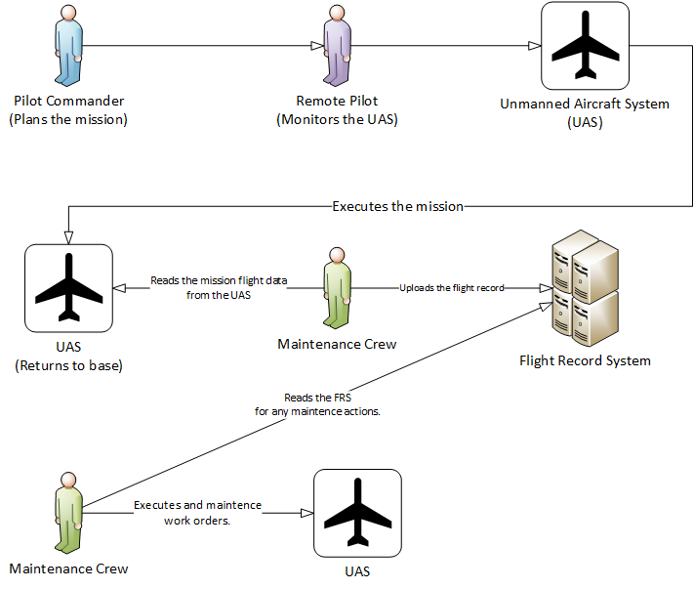
Security Model Scenario

Slide 7
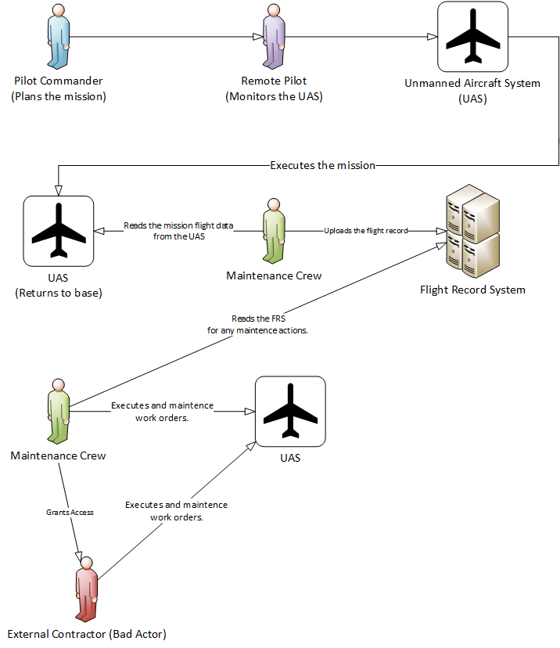
Security Model Scenario

Slide 8
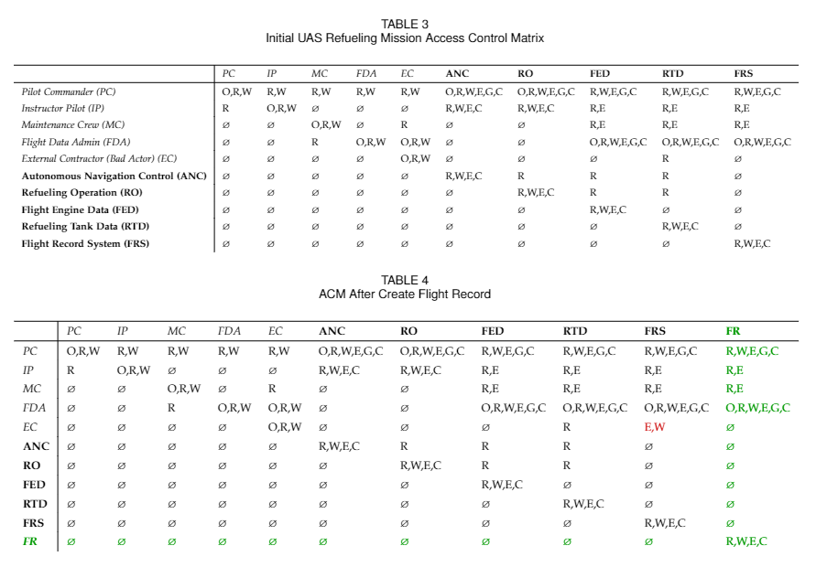
ACM & System Overview
Pilot Commander (PC): The primary remote pilot of the UAS during the mission.
Instructor Pilot (IP): Assists the Pilot Commander and can pilot the UAS if given permission from the PC or MC.
Maintenance Crew (MC): Handles work orders created by the PC, IP, or FDA, responsible for the maintenance of the UAS.
Flight Data Admin (FDA): Handles and analyses all mission flight data.
External Contractor (Bad Actor) (EC): Has a similar job to the MC however only has read rights to the FED.

Slide 9
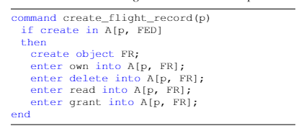
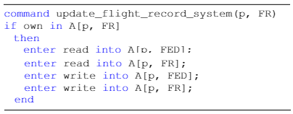
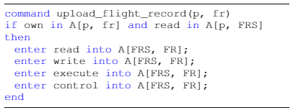
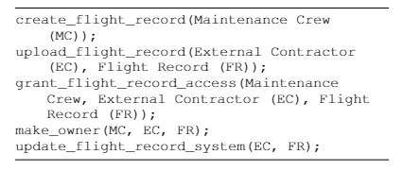
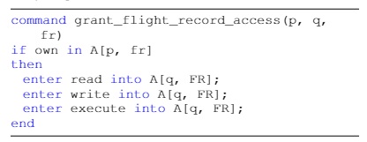
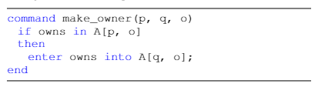
Rights Leakage: HRU

Slide 10
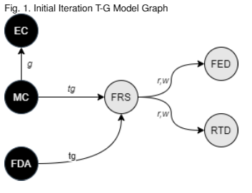
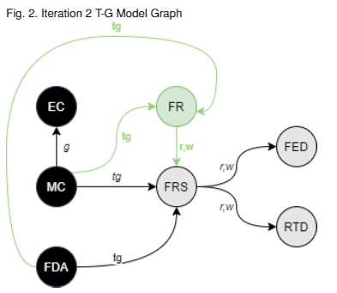
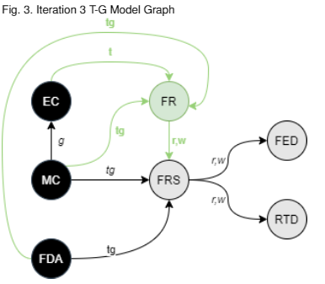
Rights Leakage: Take Grant

Slide 11
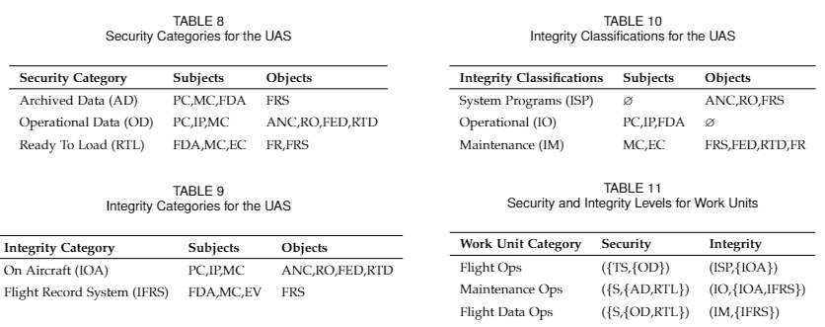
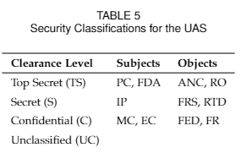
Security Classification Solutions

Slide 12
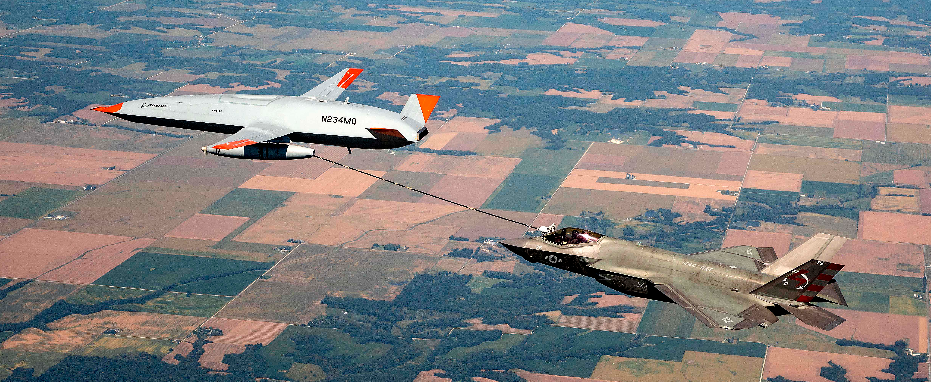
Q&A

